Slide 1
SUPERVISED ML REGRESSION CAPSTONE PROJECT BIKE SHARING DEMAND PREDICTION

Slide 2
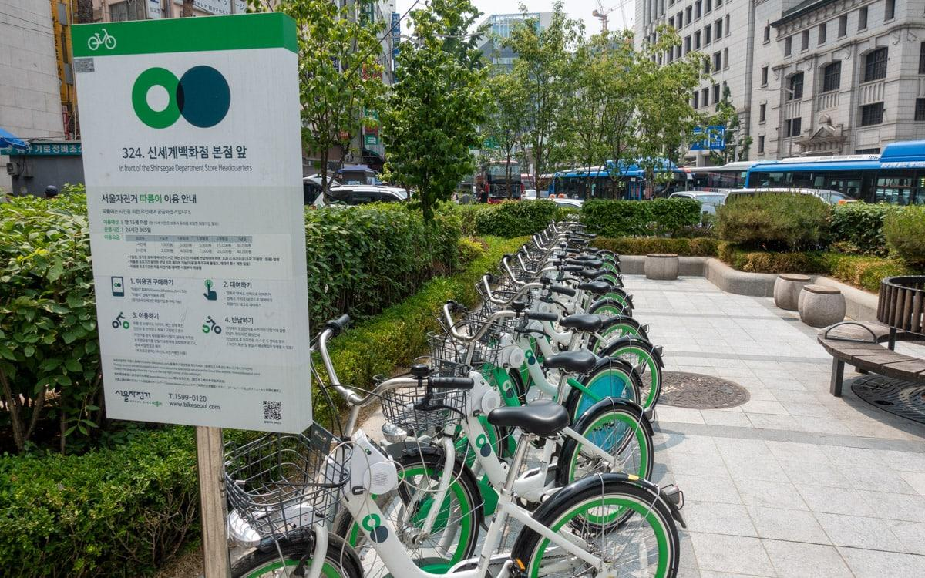
Contents
Introduction
Problem Statement
Points for discussion
Data Summary
Exploratory Data Analysis
Modeling Overview
Feature Importance
Conclusion

Slide 3
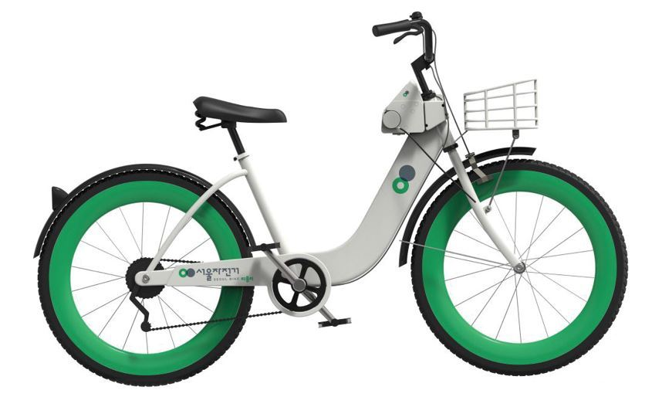
Introduction
A bike rental or bike hire business rents out motorcycles for short periods of time, Usually for a few hours. Most rentals are provided by bike shops
as a sideline to their main businesses of sales and service, but some shops specialize in rentals.
As with car rental, bicycle rental shops primarily serve people who do not have access to vehicles, typically travelers and particularly tourists.
Bike rental shops rent by the day or week as well as by the hour, and these provide an excellent opportunity for those who would like to avoid shipping their own bikes but would like to do a multi-day bike tour of a particular area.

Slide 4

Problem Statement
Currently, Rental bikes are introduced in many urban cities for the enhancement of mobility comfort.
It is important to make the rental bike available and accessible to the public at the right time as it lessens the waiting time.
Eventually, providing the city with a stable supply of rental bikes becomes a major concern.
The crucial part is the prediction of the bike count required at each hour for the stable supply of rental bikes.

Slide 5
Discussion Topics
Bike booking in each season, on functioning days, holidays, and months.
Comparing Rented Bike Count against Numerical data columns.
Checking for Linear relation between the Rented bike count and the Numerical data columns.
Climate Effect in Different seasons on Bike Sharing.
Heat Map(OR) Correlation Map.
Linear Regression analysis, Lasso Regression Analysis, Grid Search CV for Hyperparameter tuning,
Decision Tree Analysis, XG boost, and Random Forest Analysis
Feature Importance.

Slide 6
Data Analysis Steps
Imported Libraries
In this part, we imported the required libraries NumPy, Pandas, matplotlib, and seaborn, to perform Exploratory Data Analysis and for prediction, we imported the Scikit learn library.
Descriptive Statistics
In this part, we start by looking at descriptive statistic parameters for the dataset. We will use describe() this told mean, median, standard deviation
Missing Value Imputation
We will now check for missing values in our dataset. after checking not existed any missing values, In case there are any missing entries, we will impute them with appropriate values.
Graphical Representation
We will start with Univariate Analysis, bivariate Analysis and conclude with various prediction models driving the Demand for bikes.

Slide 7
Attributes of each variable
Date: Date in year-month-day format
Rented Bike Count: Count of bikes rented at each hour
Hour: Hour of the Day
Temperature: Temperature in Celsius
Humidity: Humidity in %
Windspeed: Speed of wind in m/s
Visibility (10m): Visibility
Dew point temperature: Dew Point Temp (Celsius)
Solar radiation: Radiation in MJ/m2
Rainfall: Rainfall (mm)
Snowfall: Snowfall (cm)
Seasons: Winter, Spring, Summer, Autumn
Holiday: Holiday/No holiday
Functioning Day: if the day is neither weekend, holiday than 1 else 0

Slide 8
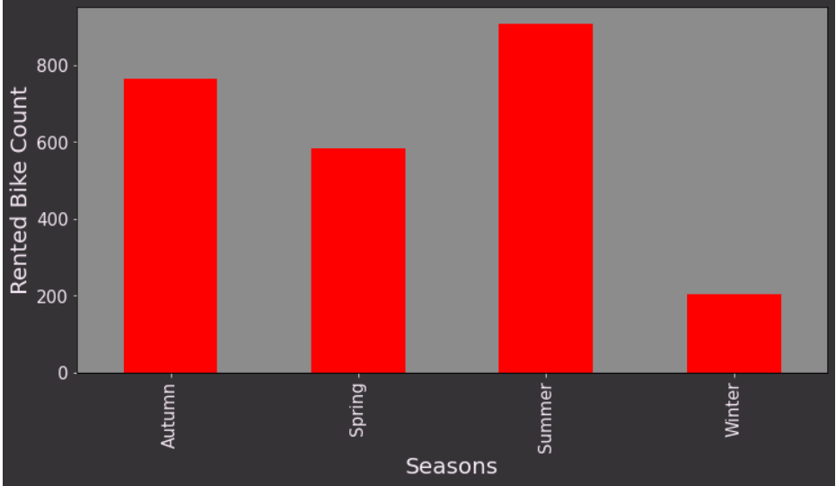
Bikes Rented per Season
Highest number of bikes were rented in Summer. The total count of bikes rented in summer was 2.28 million
Second highest Bikes were rented in Autumn around 1.79 million followed by Spring in which 1.6 million bikes are rented.
Winter appears to be the least popular season for bike rentals. In the winter, just 487K bikes were rented.
The extreme temperatures in Seoul in the winter might be a factor in the low demand for bikes in the winter.

Slide 9
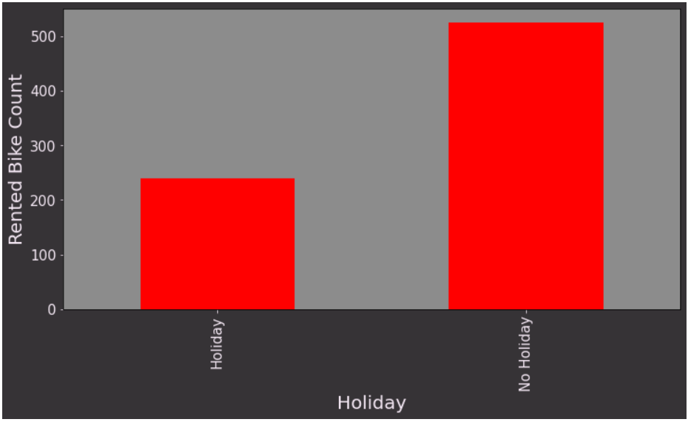
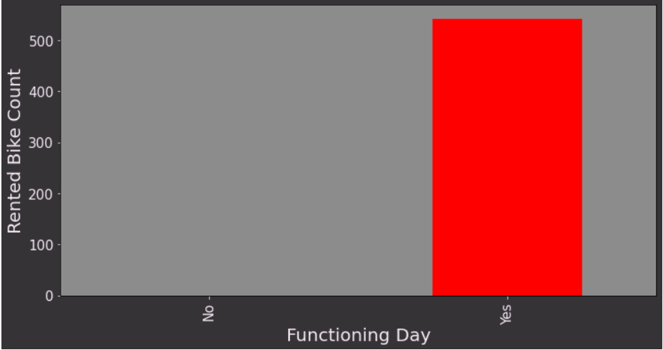
Bike Renting trend on holidays, Functioning days
People prefer to use the bike on Non-holiday more compared to Holidays.
5.9 million bikes are rented on Non-holidays, only a meager 215K bikes were rented on holidays.
It's reasonable to conclude that the majority of clients in the bike rental sector are from Seoul's working class.
All the bikes rented were on the functioning days.

Slide 10
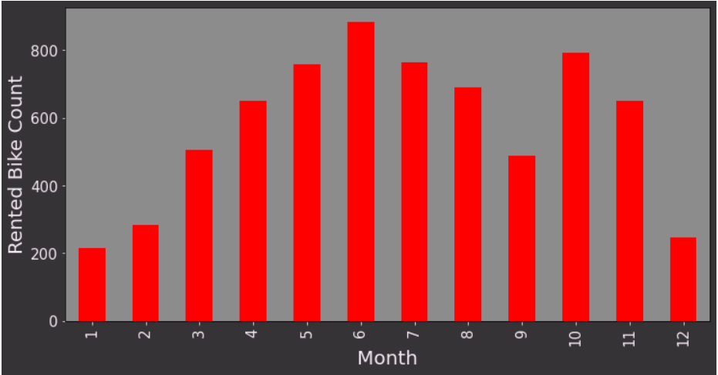
Bike Booking Monthly Trend
June is the most preferred month for bike booking around 896K bikes were rented in June.
July and May are the second and third best.734K bikes were booked in July, and 707K were booked in May.
Demand for bikes was least in Jan, followed by Feb and Dec. 150K bikes were rented in Jan, 151k in Feb, and 185K in Dec.

Slide 11
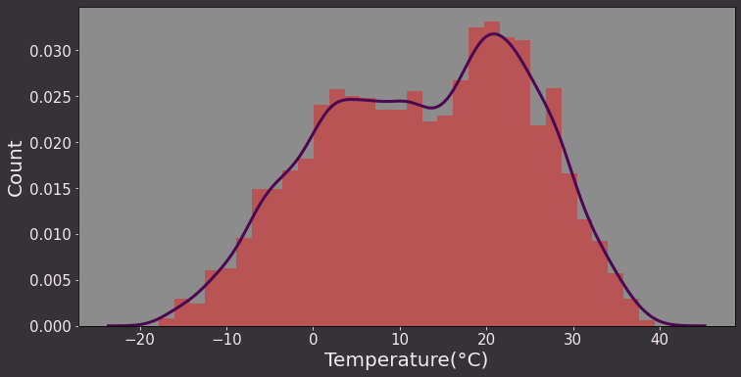
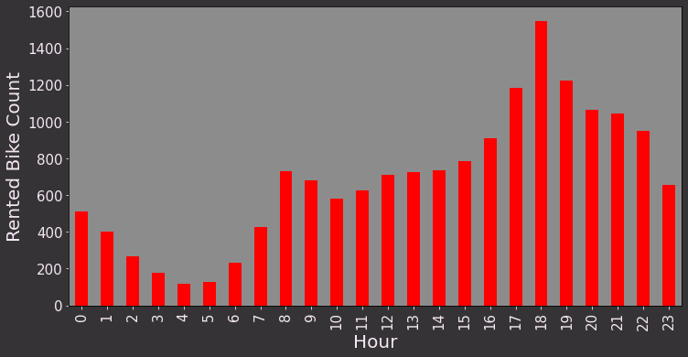
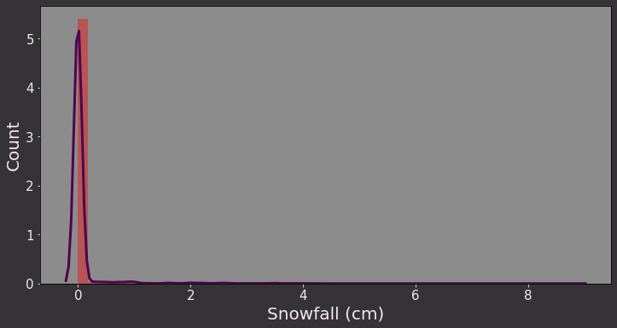
Rented Bike Count Against Numerical Data
Most preferred bike-sharing temperature is 20- 30 degrees Celsius. Bike renting is minimal when the temperature is >35 or <5 degrees Celsius.
Bike sharing is at its peak between 4 pm to 8 pm. Bike-sharing is at least between 2 am to 6 am, it increases from 6 am onwards until 8 am.
Snowfall is least favorable for the bike renting Business.

Slide 12
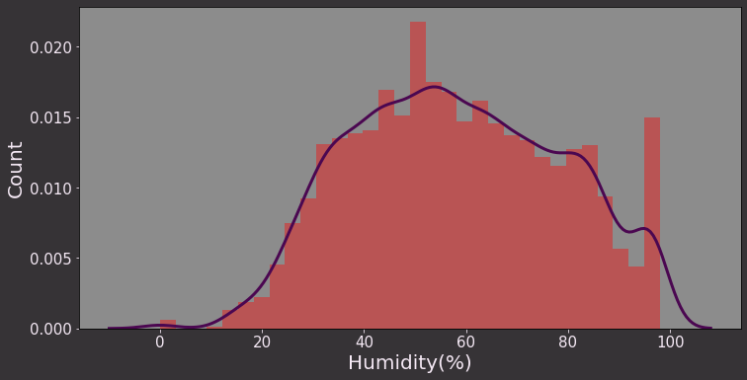
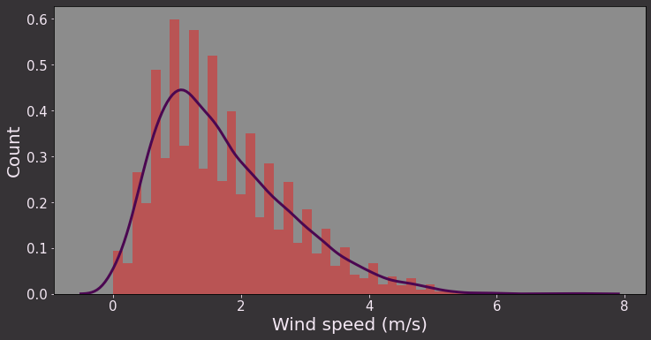
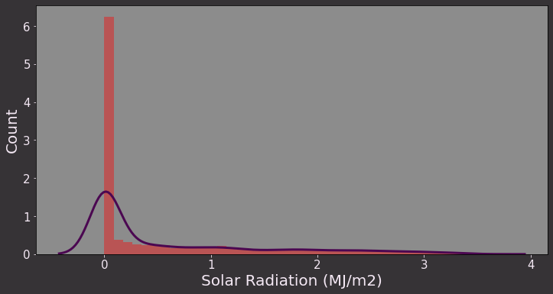
Rented Bike Count Against Numerical Data
Bike renting is at its peak when the humidity is 40%- 60%. People avoid bikes when the climate is too humid or too dry.
Favorable wind speed for Bike sharing is 1m/s -2 m/s as wind speed goes beyond 2m/s the count of bike-sharing starts dropping reaching minimal when the speed > 5m/s.
Bike sharing is at its peak when the radiation is minimal.

Slide 13
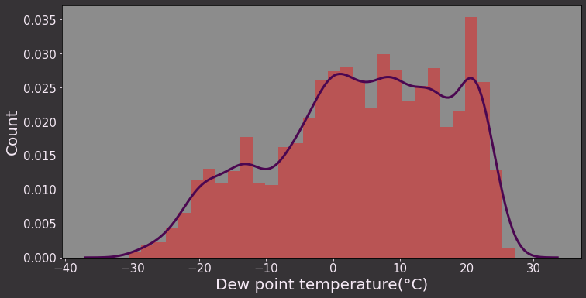
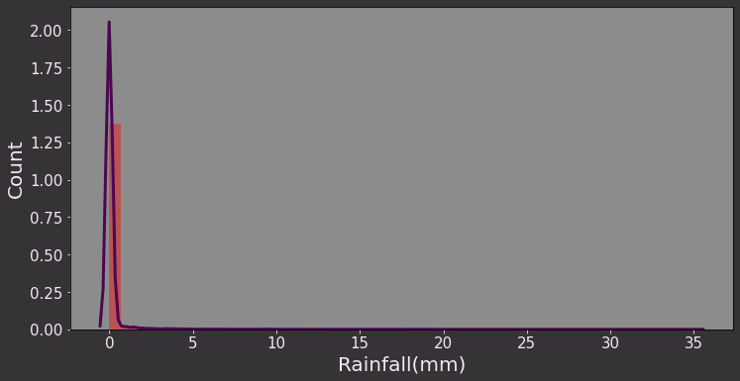
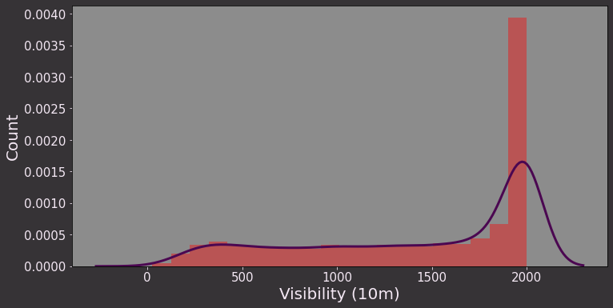
Rented Bike Count Against Numerical Data
Dew point temperature between 5-25 Degrees is most favorable for Bike sharing.
Demand for bikes dwindles in case of rainfall.
Visibility is an important factor for bike riders, bike sharing is at its peak when the visibility is maximum

Slide 14
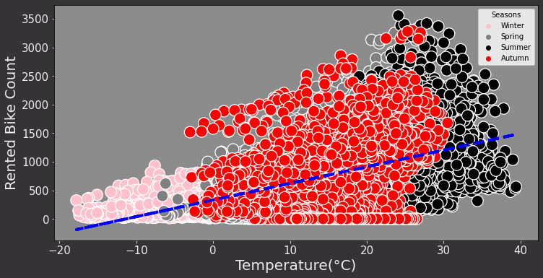
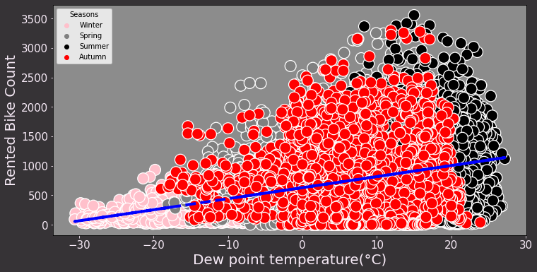
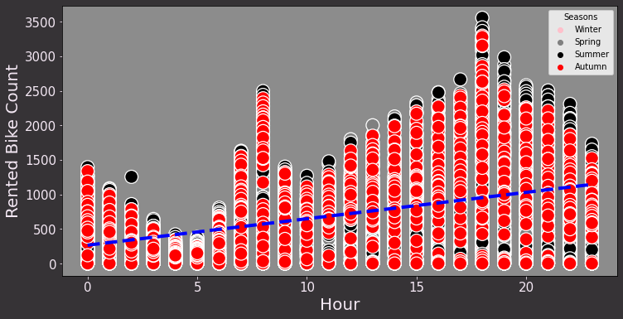
Co-relation: Rented bike count vs Temp, Dew point Temp, Hour
Bike sharing is positively co-related to temperature and Dew point Temperature as the temperature approaches 30 degrees.
Though one thing to notice the positive co-relation is applicable only because the temperature in Seoul rarely crosses 40 Degrees.
Bike sharing count is positively co-related to hours as the Hours Progress from 0 (12 am) to 20 (8 pm) the bike-sharing count increases.

Slide 15
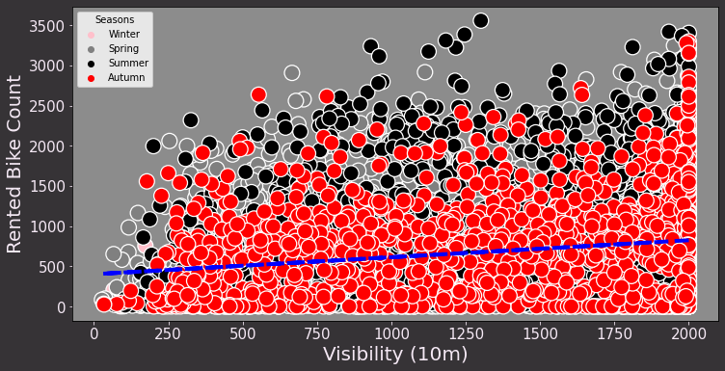
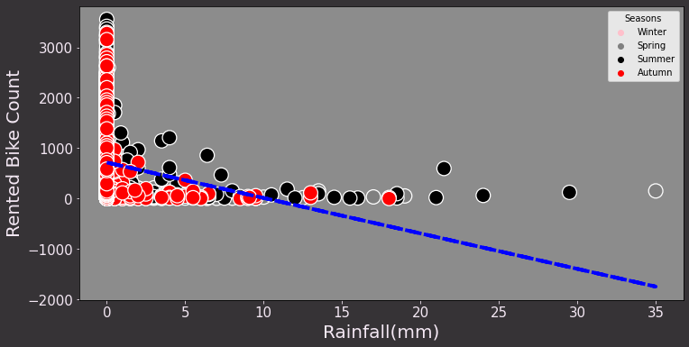
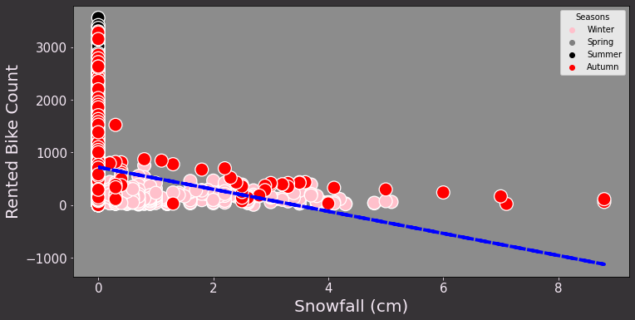
Co-relation: Rented bike count vs Visibility, Rainfall, Snowfall
Visibility is Also slightly positively co-related with Bike Bookings.
Snowfall, Rainfall are negatively co-related to Bike rented count.

Slide 16
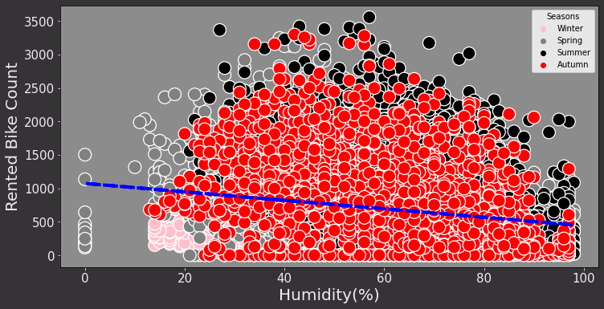
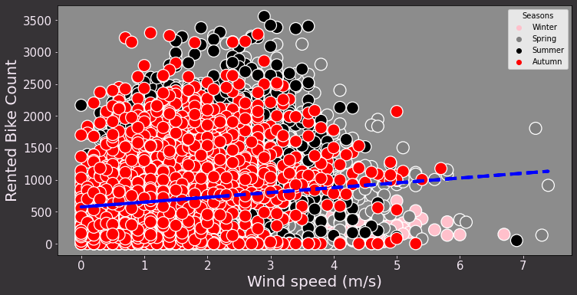
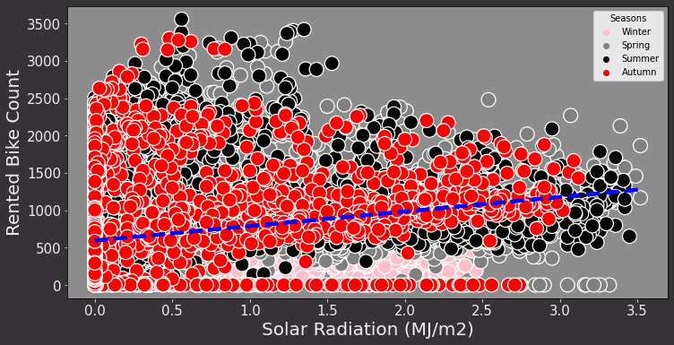
Co-relation: Rented bike count vs Humidity, Wind Speed, Radiation
The bike-sharing count is slightly negatively correlated to Humidity.
Wind speed and Solar radiation are slightly positively related to Bike-sharing count.

Slide 17
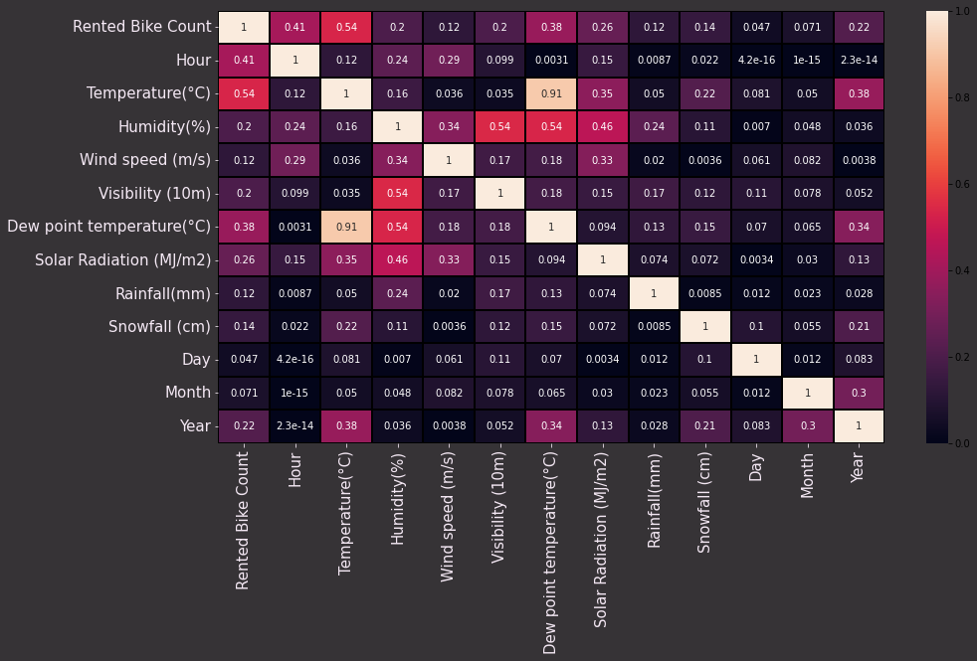
Correlation map
Heat map shows slightly positive relation of Rented bike count with Hour, Temperature, Dew point Temperature, Solar Radiation.
Bike sharing count is negatively co-related to Humidity, Snowfall, Rainfall.
Temperature and Dew point temperature are positively co-related.

Slide 18
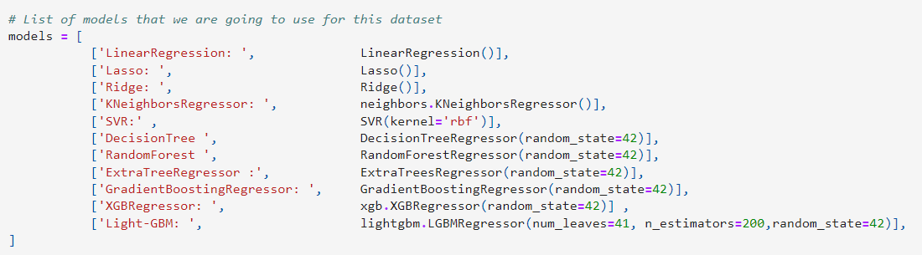
Models List
In this project we used total twelve models, so that we can compare the final Root mean square error and R2 score of this models.

Slide 19
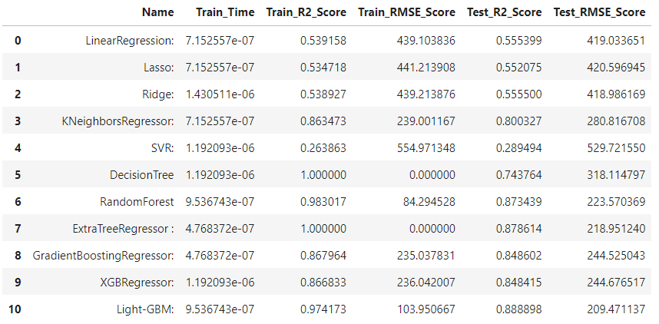
Result
As we can see clearly out of twelve models Lightgbm, ExtraTreeRegressor and RandomForestRegressor give us max R2 score and
Less Root mean square error on test set.

Slide 20
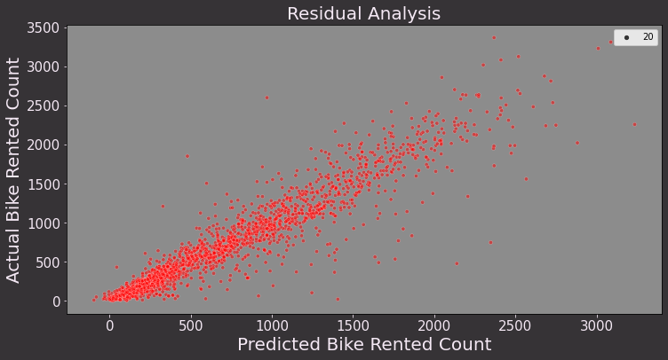
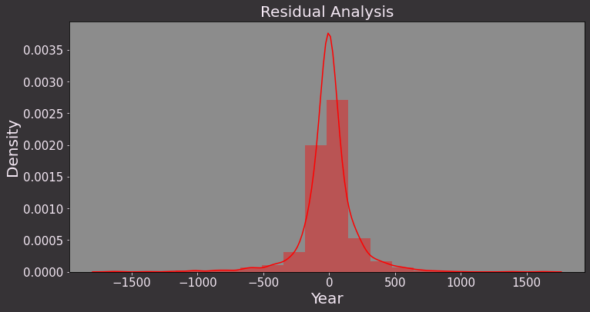
Model-1 ExtraTreeRegressor
Extratree improves the RMSE significantly on the Test set. its evident from the below plot the Predicted and actual values are much closer compared to other Models.
R-score of 0.878 and RMSE : 218.95
Residual values are reduced remarkably for the Extratree. The KDE plot is much leaner and most of the Residual values are closer to zero.

Slide 21
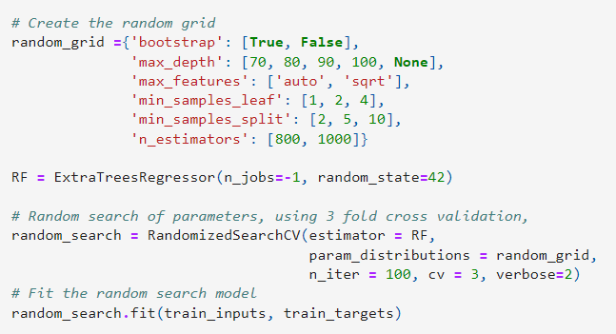

Hyperparameter Tuning of ExtraTreeRegressor
For Hyperparameter tunning we used random search cv method to find best hyper-paramters for our model.
R2 Score after Hyperparameter tunning increased by 0.76% only
R-Score .885 and RMSE : 212.78 .

Slide 22
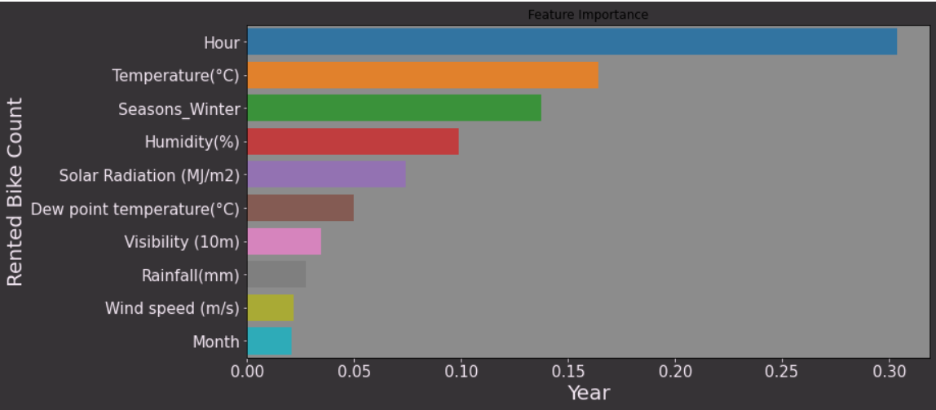
Feature Importance
The adjacent Graph shows the importance of the features on our Rented bike count.
Temperature and Hour of the day is a major factors driving the demand for bikes.
Solar Radiation, Humidity, Rainfall, where its working day or not are other variables driving the demand for bikes.

Slide 23
Model 2 - Light GBM
LightGBM is a gradient boosting framework that uses tree based learning algorithms. It is designed to be distributed and efficient with the following advantages:
1. Faster training speed and higher efficiency. 2. Lower memory usage. 3. Better accuracy. 4. Support of parallel, distributed, and GPU learning. 5. Capable of handling large-scale data.
LightGBM improves the RMSE significantly on the Test set. its evident from the below plot the Predicted and actual values are much closer compared to other Models.
R-score of 0.878 and RMSE : 218.95

Slide 24
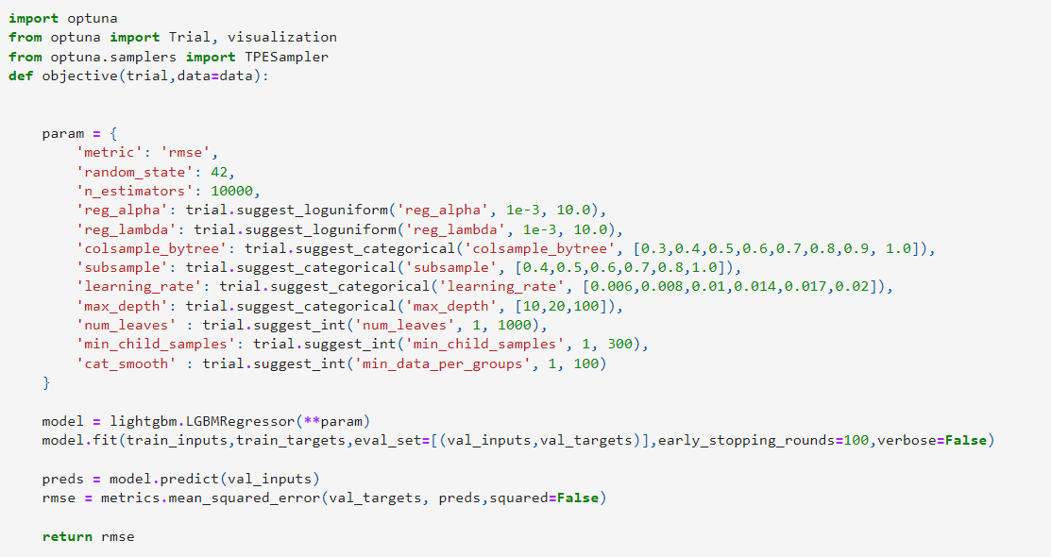
Hyperparameter Tuning of LightGBM
For Hyperparameter tunning we used Optuna
Library to find best hyper-paramters
for our model.
Optuna works on Bayesian search method.

Slide 25
Conclusion
Most numbers of Bikes were rented in Summer, followed by Autumn, Spring, and Winter. May-July is the peak Bike renting Season, and Dec-Feb is the least preferred month for bike renting.
Majority of the client in the bike rental sector belongs to the Working class. This is evident from EDA analysis where bike demand is more on weekdays, working days in Seoul.
Temperature of 20-30 Degrees, evening time 4 pm- 8 pm, Humidity between 40%-60% are the most favorable parameters where the Bike demand is at its peak.
Temperature, Hour of the day, Solar radiation, and Humidity are major driving factors for the Bike rent demand.
Feature and Labels had a weak linear relationship, hence the prediction from the linear model was very low. Best predictions are obtained with a LightGBM as r2 score of 0.894 and RMSE of 203.91

Slide 26
Thank You

